Slide 2
Autumn Budget 2024 – A Budget to invest, invest, invest (and tax)

Slide 3
About Cratus Group
Corporate affairs
Strategy, reputation management, crisis comms, PR, Media engagement
Government relations
National influencing and policy
Experts in:
Local, Regional and national political strategy
Reputation management
Planning and politics
Strategic local public affairs
Experts in local politics and engagement
Planning and strategic land
Land lend engagement, supporting developers through the planning process
Placemaking and Community engagement
Experts in local campaigning
Creative, Digital and social media
Experts in creative campaigns

Slide 4
Purpose and plan

Slide 5
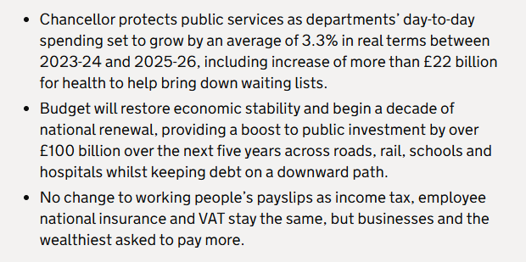
Labour’s first Budget
What was it for?
Source: HM Treasury Press Release 30 October, 2024
Notes:
A lot of talk about “Fixing the Foundations” / “Certainty for business” / “Making difficult choices” / “Looking after working people”
Rachel Reeves was desperate to ensure the financial markets were not going to go on a run – hence the extensive trailing

Slide 6
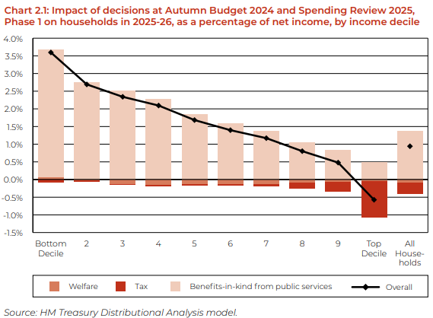
Labour’s first Budget
Who was it for?
Note: graph does not include the effect of increased Employers NI
Source: HM Treasury Red Book 30 October, 2024
Notes:
Labour want the public to believe that the Budget was to support working people while tackling under investment
This Budget is a down payment on longer term departmental spending plans

Slide 7
£22.6bn extra
for the NHS
£5bn for Housing
(£3.1bn of
which for Affordable)
Budget highlights
Tax & borrowing to raise £40bn
£2.3bn for schools
Employer National Insurance up
by 1.2%

Slide 8
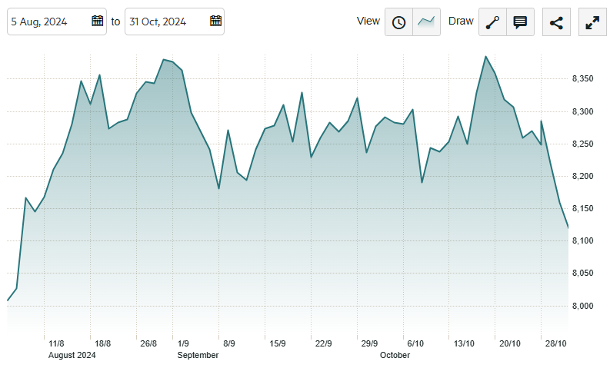
Labour’s first Budget
What did the markets think?
Source: Investors Chronicle

Slide 9
Key areas

Slide 10
Employers NI increase to raise £25bn
Tax increases (Repairing the public finances)
Employers' National Insurance up 1.2% to 15% from April 2025
Capital Gains Tax up from 10% - 18% (lower rate) / 20% - 24% (higher rate)
Agricultural property relief: 100% for the first £1 million / 50% after the first £1 million (from April 2026)
Reform to non-dom status
Stamp duty will rise on second homes from 3-5%

Slide 11
£22.6bn increase to NHS budget
Health
4% NHS Budget uplift
£600m social care grant funding
£3.1bn extra capital spending to £13.6bn, inc
£1.5bn for new surgical hubs
£1bn to tackle RAAC
£2bn for tech
Undefined fund for GP surgeries
£460m for pandemic preparedness
£26m for mental health centres

Slide 12
MHCLG spending growth of 9.7%
Housing and planning
£500m extra on the Affordable Home programme – to £3.1bn - for an extra 5,000 Affordable Homes
£47m to support 28,000 homes stalled due to nutrient neutrality
£3bn for SME and BTR sector through housing guarantee scheme
Housing rent settlement of CPI +1%
£50m to “expedite” the planning process – inc. 300 new planners
£10m for Cambridge Growth Company to develop a plan for the housing, transport, water, and wider infrastructure.
Notes:
Planning & Infrastructure Bill to be published "early next year"

Slide 13
Limited additional funding for councils
Local Government
English Devolution White Paper due shortly
New round of Combined Authorities
Replacement of Districts and Boroughs with Unitaries
Consideration being given to coordination with ICBs
Efficiency savings expected
Additional SEND funding will be welcomed
Strong sectoral desire for multi-year financial clarity

Slide 14
-£2.5bn real terms growth
Transport
Bus fare cap up to £3
Extra £500m for road maintenance (potholes)
£100m for cycling & walking infrastructure
£200m for EV charging infrastructure
Commitments to:
East – West Rail
Trans-Pennine upgrades
HS2 to Euston
Additional road schemes (A47 / A57 / A75)

Slide 15
£6.7bn capital investment programme
Education
3.6% increase including addition funds provided in July
£2.3bn core school funding – pupil funding
£1bn increase in SEND provision
£8bn on early years and children funding
£6.7bn for capital investment with extra £1.4bn for school rebuilding

Slide 16
Opposition views

Slide 17
Conservative views
Liberal Democrat views
Economy wasn’t broken and no £20bn back hole
Nevertheless raised £40bn not £20bn
Not fixing productivity issues in Civil Service or dealing with those not working
Growth rates are actually down
Not in Manifesto
Welcome NHS funding but more needed
Social care needs more attention
Big win on Carer’s Allowance increase and review of overpayments
Disappointed on Local Government funding
Against Winter Fuel cuts

